Slide 1
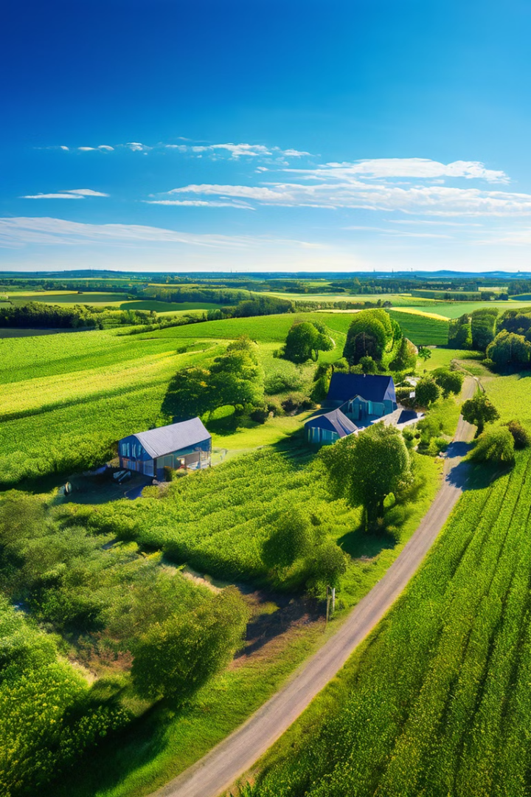
Smart Irrigation System: Precision Farming
A revolutionary irrigation system utilizing AI and IoT technology for optimized crop management and maximized yields. Precision farming is a modern approach to agriculture that uses technology and data to improve efficiency and sustainability.

Slide 2
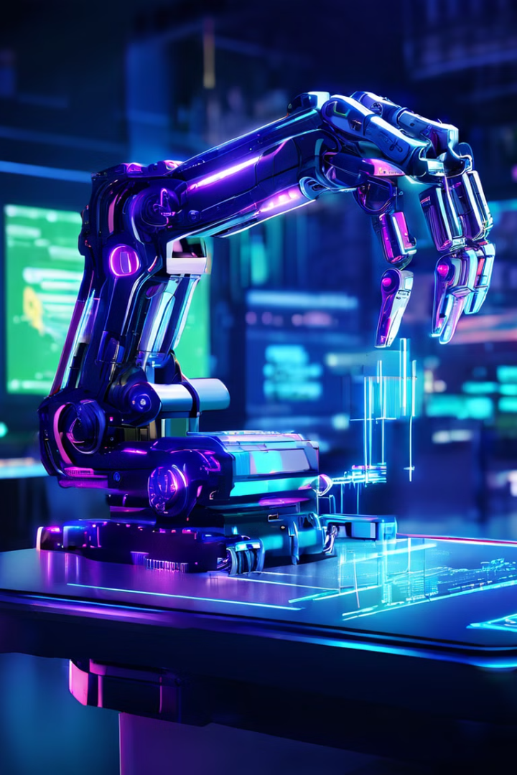
Technologies: AI and IoT
The system leverages powerful AI algorithms for advanced data analysis and decision-making. The Internet of Things (IoT) enables real-time data collection and communication between various components of the system.
AI
Artificial intelligence analyzes data to optimize irrigation strategies, predict crop needs, and enhance farm efficiency.
IoT
Internet of Things connects various sensors, actuators, and devices, facilitating data exchange and remote control.

Slide 3
Data Collection and Crop Recommendation
Sensors gather crucial data about soil moisture, temperature, and other environmental factors. Machine learning algorithms process this data to recommend optimal crops suited for the specific conditions.
Data Collection
Crop Recommendation
Sensors gather soil moisture, temperature, nutrient levels, and other environmental data.
Machine learning algorithms analyze data to recommend suitable crops based on the specific environmental conditions and soil properties.
Soil Moisture Sensors
Temperature Sensors
Nutrient Sensors

Slide 4
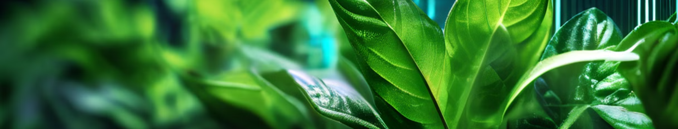
Crop Condition Monitoring and Alerts
The system continuously monitors crop health, analyzes data for potential issues, and sends timely alerts to farmers, enabling proactive intervention.
1
Monitoring
2
Analysis
3
Alerts
Sensors track plant growth, water consumption, and other indicators of crop health.
AI analyzes data to detect anomalies and predict potential problems, such as disease or pests.
The system sends notifications to farmers about potential issues, allowing for timely interventions.

Slide 5
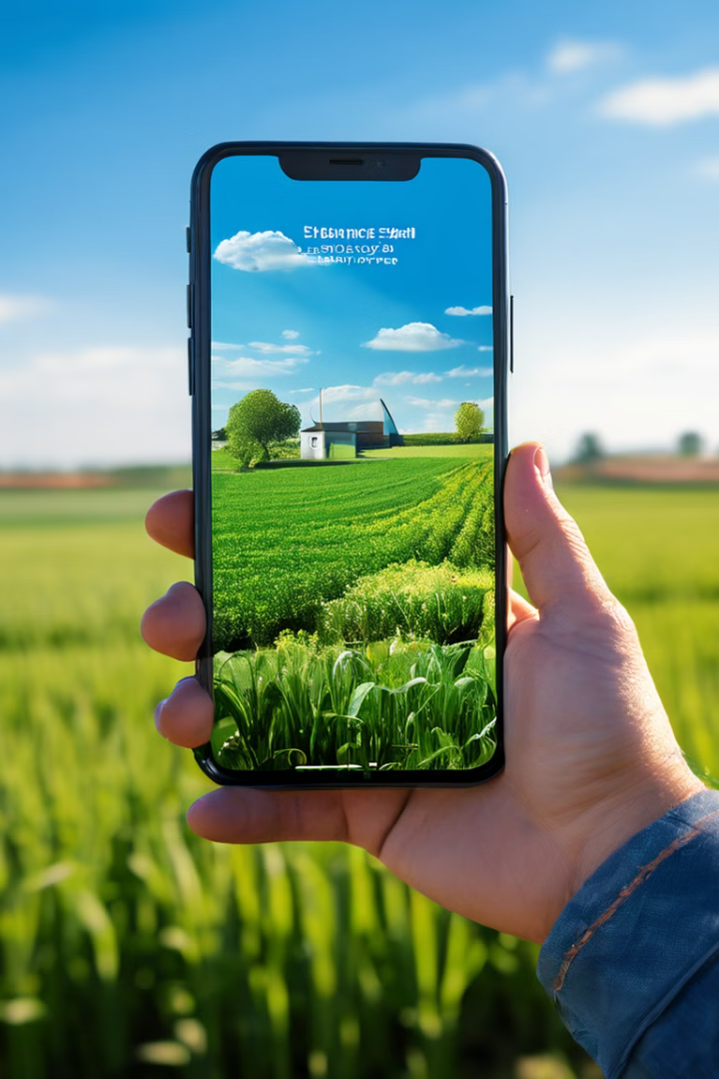



Mobile App Integration
Farmers can conveniently access real-time data, manage irrigation schedules, and receive alerts through a user-friendly mobile application.
Control Panel
Farmers can adjust irrigation settings, monitor sensor data, and manage alerts.
Data Dashboard
Visualizations of key data points, such as soil moisture, temperature, and crop growth.
Alerts and Notifications
Real-time alerts about potential issues, ensuring timely intervention.

Slide 6
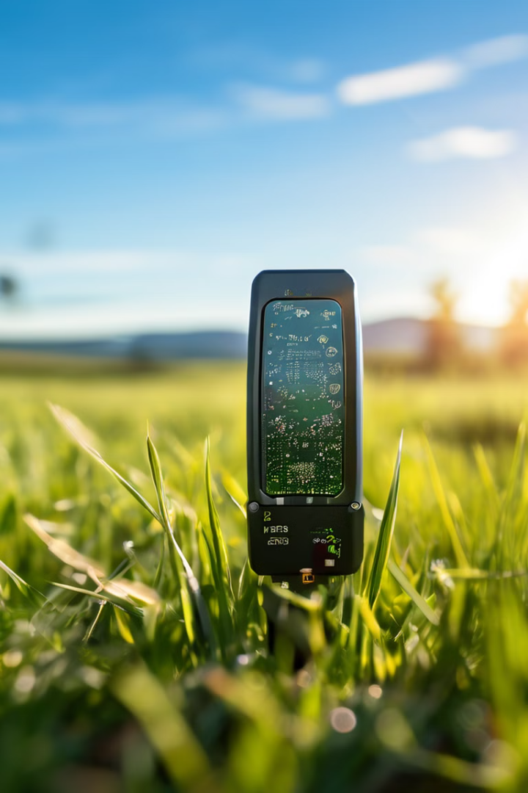
Sensors for Data Collection
Various sensors strategically placed throughout the farm collect crucial data about the land and environment. This data is then transmitted to the central system for analysis and decision-making.
Sensor Type
Data Collected
Soil Moisture Sensors
Moisture levels in the soil
Temperature Sensors
Air and soil temperature readings
Nutrient Sensors
Levels of essential nutrients in the soil
Weather Sensors
Rainfall and humidity data

Slide 7
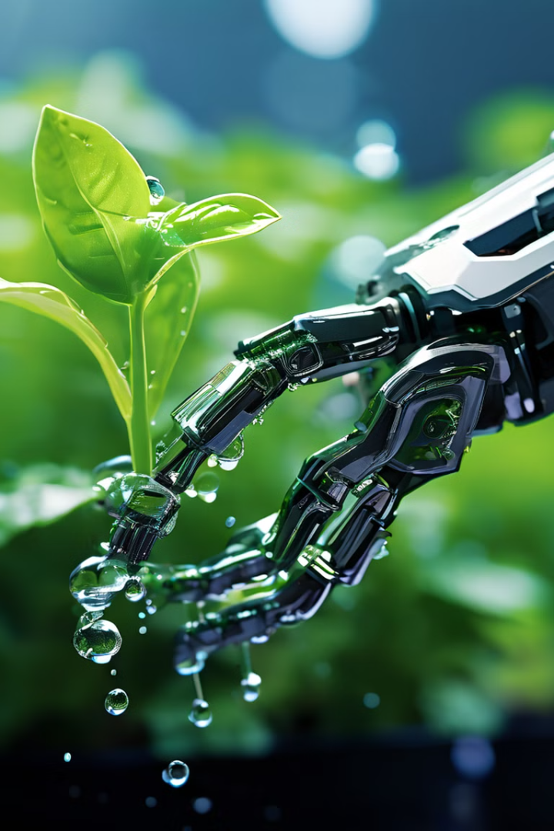



Actuators for Remote Control
Actuators are devices that respond to commands from the central system and perform actions, such as controlling irrigation valves and adjusting sprinklers.
Irrigation Valves
Control the flow of water to different sections of the farm.
Sprinklers
Adjust the watering patterns and intensity based on specific needs.
Fertilizer Dispensers
Release fertilizers according to the requirements of the crops.

Slide 8
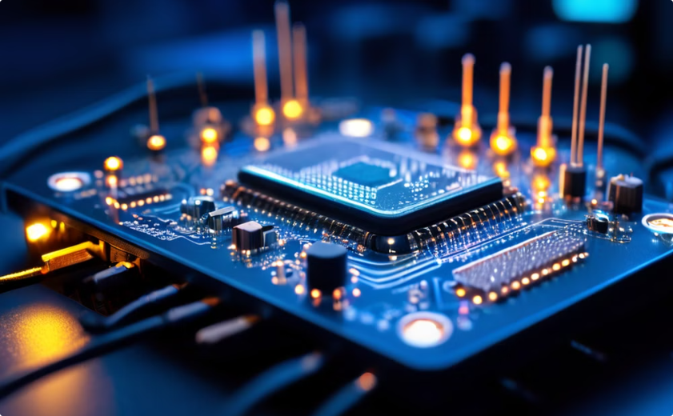
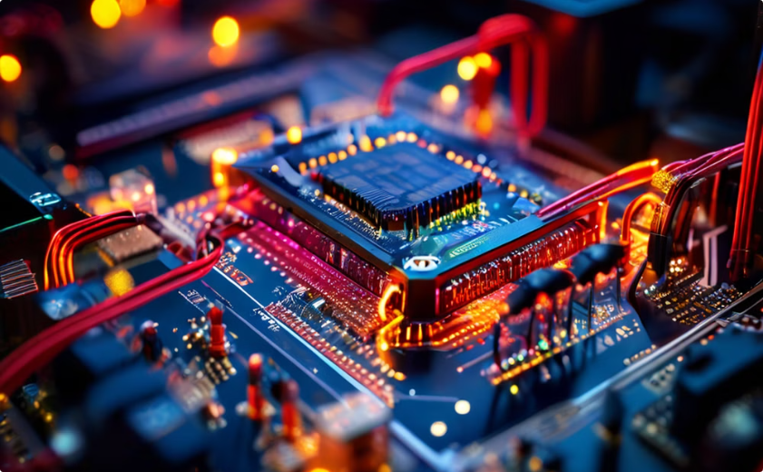
Microcontrollers and Data Sharing
Microcontrollers like ESP32 and Raspberry Pi process data collected from sensors, execute AI algorithms, and manage actuators for irrigation control. They connect to a network to share data with the mobile application.
ESP32
Raspberry Pi
A powerful microcontroller widely used in IoT projects.
A versatile single-board computer suitable for complex data processing.

Slide 9
Mobile Application with Real-Time Data
The mobile application provides farmers with a centralized platform for managing their irrigation system, monitoring crop health, and receiving real-time alerts.
Data Dashboard
Control Features
Visualizations of real-time sensor data, such as soil moisture, temperature, and nutrient levels.
Adjust irrigation schedules, monitor sensor data, and receive alerts through a user-friendly interface.
Graphs and Charts
Maps and Location Data
Customizable Dashboards

Slide 10
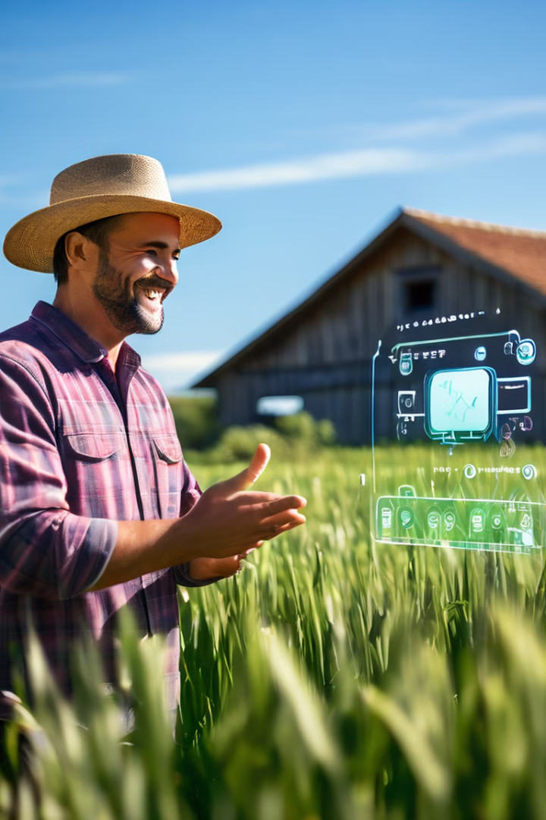
Future Enhancements with Chatbot
Integration of a chatbot can provide farmers with 24/7 access to information, troubleshooting assistance, and personalized recommendations.
1
Automated Support
Farmers can ask questions about crop management, irrigation, and potential issues.
2
Personalized Recommendations
The chatbot can provide customized recommendations based on the farmer's specific conditions and needs.
3
Real-Time Information
Access to up-to-date information on weather patterns, crop prices, and market trends.

Slide 11
A Solution By
Shyam J
Madhan Rao C S
Harish Kumar K R K
Dhatchin S S
Jai Harini K S
Priya Darshini R

